Slide 1


Brett Shelley
August 2022

Slide 2

Outline
Executive Summary
Introduction
Methodology
Results
Conclusion
Appendix

Slide 3
Executive Summary
The goal of analysis is to build a model to predict whether or not a SpaceX Falcon 9 stage 1 rocket will be landed successfully so that it is able to be reused
Data was compiled on Falcon 9 launches, including multiple factors and variables regarding the rocket used and the circumstances of the launch, including launch site, payload mass, orbit type, and flight number
The data was processed by using one hot encoding to turn categorical data into numerical data, normalizing the data, and splitting the data into train and test sets
Logistic regression, K nearest neighbor, classification tree, and support vector machine algorithms were fit to the training data and evaluated for accuracy in predicting the test data set outcomes.
All of the algorithms, excluding K nearest neighbor, predicted landing outcomes with greater than 83% accuracy

Slide 4
Introduction
SpaceX is able to keep rocket launch costs for the Falcon 9 rocket low by reusing the first stage of the rocket when it can be landed successfully
By being able to predict if the first stage can be reused or not, we can more accurately determine the true cost of individual rocket launches
Using publicly available data and machine learning algorithms, we will attempt to build a classification model to predict whether or not the Falcon 9 rocket first stage will be successfully landed so it can be reused

Slide 5

Section 1

Slide 6
Methodology
Data collection methodology:
Data was collected directly from SpaceX using their API to retrieve launch data
Data was also collected from publicly available records online using web scraping
Perform data wrangling
The data was cleaned to remove unnecessary and null values
Used one hot encoding to transform categorical data into numerical data for analysis
Perform exploratory data analysis (EDA) using visualization and SQL
Perform interactive visual analytics using Folium and Plotly Dash
Perform predictive analysis using classification models
Built multiple classification models using different machine learning algorithms to evaluate and choose the best predictive model

Slide 7
Data Collection
Data was collected from two sources, directly from SpaceX using their public facing API, as well as from public data available on Wikipedia.org
Data was compiled to include Date, Flight Number, Payload Mass, Orbit Type, Launch Site, Outcome, and Landing Pad for Falcon 9 rocket launches
The resulting data was prepared for processing by replacing 5 missing values of Payload Mass with the mean of all payload masses

Slide 8
Data Collection – SpaceX API
Use REST get request to https://api.spacexdata.com/v4 to retrieve past rocket launch information as JSON data
Read JSON data in pandas dataframe
Filter the resulting dataframe to only include data for Falcon 9 launches
https://github.com/brettshelley/IBM_Coursera_Capstone/blob/f9faa45eddc844811384cee2d7ef0e16533ad78a/Data_Collection_SpaceX_API.ipynb
Place your flowchart of SpaceX API calls here

Slide 9
Data Collection - Scraping
Use REST get request to https://en.wikipedia.org/wiki/List_of_Falcon\_9\_and_Falcon_Heavy_launches to retrieve supplementary data
Use beautifulsoup to parse web page data into a pandas dataframe
https://github.com/brettshelley/IBM_Coursera_Capstone/blob/f9faa45eddc844811384cee2d7ef0e16533ad78a/Data_Collection_Web_Scraping.ipynb
Place your flowchart of web scraping here

Slide 10
Data Wrangling
Used one hot encoding to create a numerical label for successful Falcon 9 rocket landings from the categorical data of multiple different landing outcomes
https://github.com/brettshelley/IBM_Coursera_Capstone/blob/f9faa45eddc844811384cee2d7ef0e16533ad78a/Data_Wrangling.ipynb

Slide 11
EDA with Data Visualization
Used scatter plots, bar charts, and line plots to explore the relationships between different launch variables and the landing outcome to help identify which features may be most significant
https://github.com/brettshelley/IBM_Coursera_Capstone/blob/f9faa45eddc844811384cee2d7ef0e16533ad78a/EDA_Visualizations.ipynb

Slide 12
EDA with SQL
Used SQ L queries to pull identify specific records from the dataset to help understand the overall dataset and trends within the data
select unique(LAUNCH_SITE) from SPACEXDATASET
select avg(payload_mass__kg_) from spacexdataset where booster_version = 'F9 v1.1'
select date from spacexdataset where landing__outcome = 'Success (ground pad)' order by date asc limit 1
select mission_outcome, count(*) as count from spacexdataset group by mission_outcome
https://github.com/brettshelley/IBM_Coursera_Capstone/blob/f9faa45eddc844811384cee2d7ef0e16533ad78a/EDA_SQL.ipynb

Slide 13
Build an Interactive Map with Folium
Used Folium to add markers to and display a map visualizing the different launch sites used for the Falcon 9 rockets and their corresponding landing success rates
Clusters were used to display multiple launches for a single site since there are many individual records for each site.
Lines and distance measurements were also added to the map to examine the possible influencing factor of nearby geographical features
https://github.com/brettshelley/IBM_Coursera_Capstone/blob/f9faa45eddc844811384cee2d7ef0e16533ad78a/Visualizations_Folium.ipynb

Slide 14
Build a Dashboard with Plotly Dash
Created a dashboard to be able to see landing success rates for all sites, and for each individual site.
The dashboard also contained a selection criteria for payload mass which allows a user to select different payloads and see the resulting effect on landing outcomes
https://github.com/brettshelley/IBM_Coursera_Capstone/blob/5b18e84dabf519072dfa6e62bdebd3cef1c73910/Visualizations_Plotly.py

Slide 15
Predictive Analysis (Classification)
Using cross fold validation, multiple models were trained to predict the landing outcome of Falcon 9 rockets. The models were tested on subsets of our historical data to evaluate which has the best accuracy.
The models created were K nearest neighbors, classification tree, support vector machine, and logistic regression
https://github.com/brettshelley/IBM_Coursera_Capstone/blob/f9faa45eddc844811384cee2d7ef0e16533ad78a/Predictive_Analysis.ipynb

Slide 16
Results
With the public data available, using multiple feature analysis and machine learning algorithms, it was determined that whether or not a Falcon 9 rocket launch would result in a successful landing of the first stage could be predicted with greater than 83% accuracy
Classification tree, logistic regression, and support vector machine models all performed similarly on test data with approximately 83% accuracy, while the k nearest neighbors model performed worst with a 78% accuracy score.

Slide 17

Section 2

Slide 18
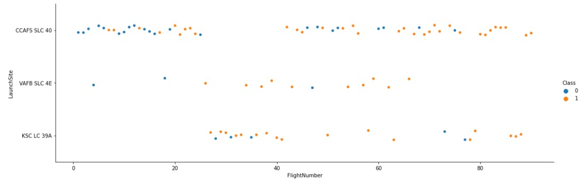
Flight Number vs. Launch Site
The plot shows the flight number of each launch plotted against its launch site, as well as the landing outcome indicated by color.
This can give us insight into the fact that earlier flights had much fewer successful landings

Slide 19
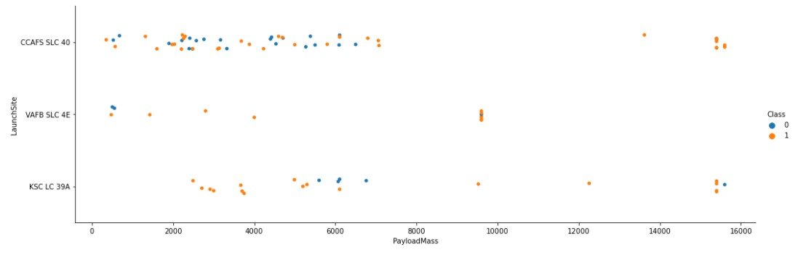
Payload vs. Launch Site
The plot shows the payload mass of each launch plotted against its launch site, as well as the landing outcome indicated by color.
This plots shows a trend that indicate that heavier payloads are more likely to result in a successful landing

Slide 20
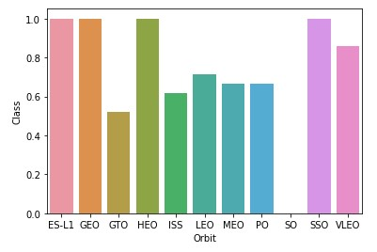
Success Rate vs. Orbit Type
The plot shows the orbit type of each launch plotted with its average rate of successful landings
This can give us insight into the fact that certain orbit types have significantly higher success rates

Slide 21
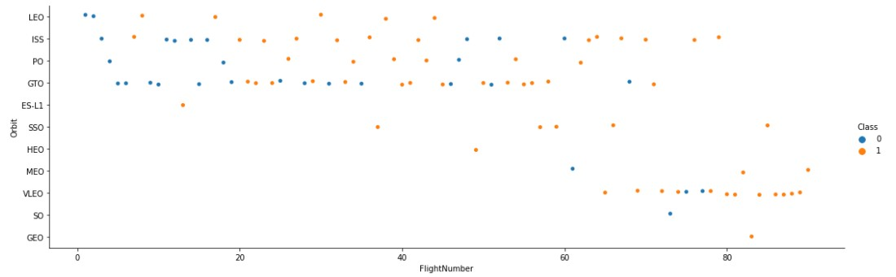
Flight Number vs. Orbit Type
The plot shows the flight number of each launch plotted against its orbit type as well as the landing outcome indicated by color.
This plots shows how the types of orbit have varied over time, with earlier launches primarily targeting different orbits than later launches

Slide 22
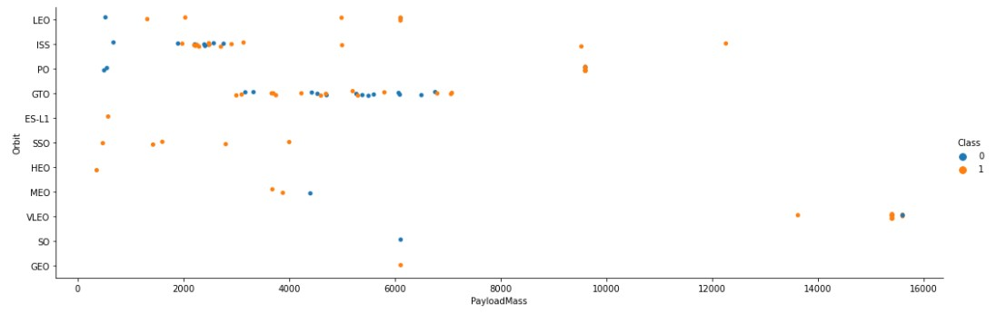
Payload vs. Orbit Type
The plot shows the payload mass of each launch plotted against its orbit type as well as the landing outcome indicated by color.

Slide 23
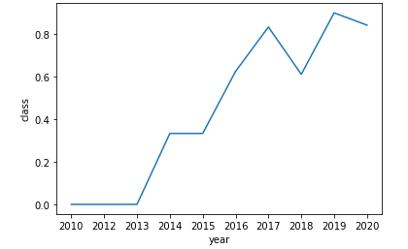
Launch Success Yearly Trend
The plot shows the rate of successful landings by year, showing a general increase in success rate over time

Slide 24
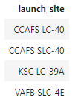
All Launch Site Names
SELECT unique(launch_site) FROM spacexdataset

Slide 25
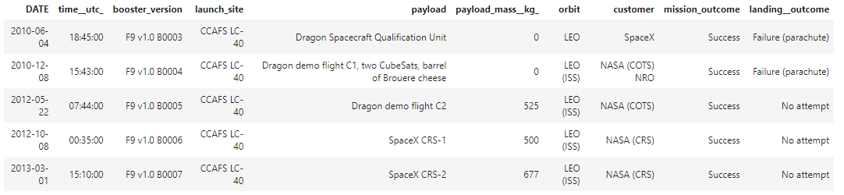
Launch Site Names Begin with 'CCA'
SELECT * FROM spacexdataset WHERE launch_site LIKE 'CCA%' limit 5

Slide 26
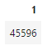
Total Payload Mass
SELECT sum(payload_mass__kg_) FROM spacexdataset WHERE customer = ‘NASA (CRS)’

Slide 27
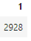
Average Payload Mass by F9 v1.1
SELECT avg(payload_mass__kg_) FROM spacexdataset WHERE booster_version = 'F9 v1.1'

Slide 28
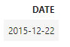
First Successful Ground Landing Date
SELECT date FROM spacexdataset WHERE landing__outcome = ‘Success (ground pad)’ ORDER BY date ASC LIMIT 1

Slide 29
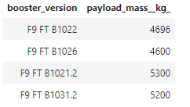
Successful Drone Ship Landing with Payload between 4000 and 6000
SELECT booster_version, payload_mass__kg_ FROM spacexdataset WHERE landing__outcome = 'Success (drone ship)' AND payload_mass__kg_ > 4000 AND payload_mass__kg_ < 6000

Slide 30
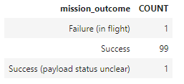
Total Number of Successful and Failure Mission Outcomes
SELECT mission_outcome, count(*) as count FROM spacexdataset GROUP BY mission_outcome

Slide 31
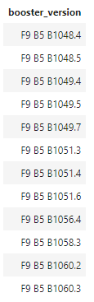
Boosters Carried Maximum Payload
SELECT distinct(booster_version) FROM spacexdataset WHERE payload_mass__kg_ = (SELECT max(payload_mass__kg_) FROM spacexdataset)

Slide 32
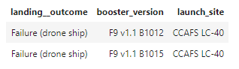
2015 Launch Records
SELECT landing__outcome, booster_version, launch_site FROM spacexdataset WHERE landing__outcome = 'Failure (drone ship)' and year(date) = '2015'

Slide 33
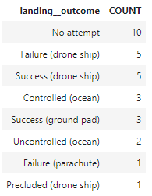
Rank Landing Outcomes Between 2010-06-04 and 2017-03-20
SELECT landing__outcome, count(*) as count FROM spacexdataset WHERE date > '2010-06-04' and date < '2017-03-20' GROUP BY landing__outcome ORDER BY count desc

Slide 34

Section 3

Slide 35
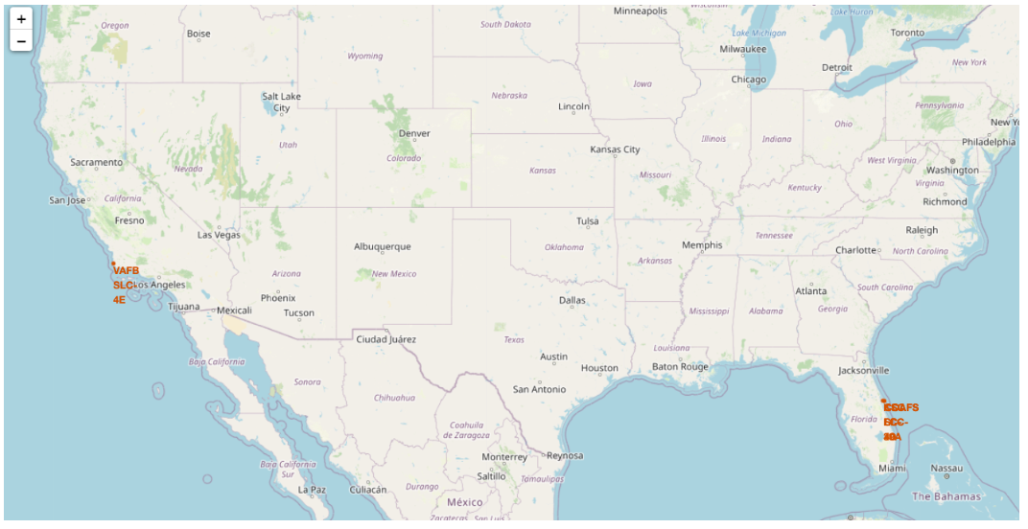
Falcon 9 Launch Sites
This map shows the locations of the different sites for Falcon 9 launches

Slide 36
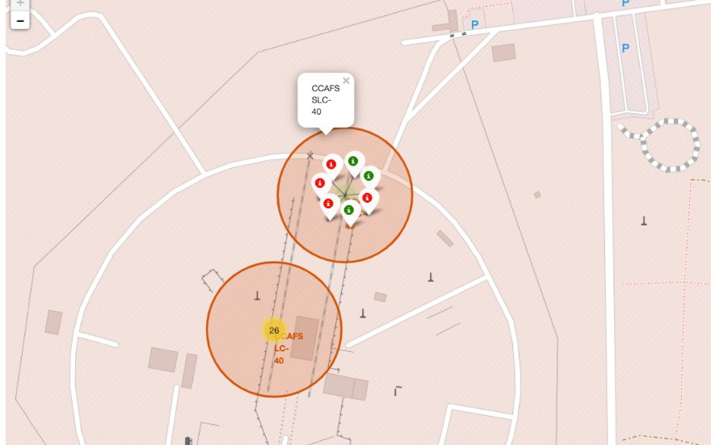
Labeled Clusters
This map shows a close up of a launch site as well as color coded labels indicating the landing success of failure of individual launches

Slide 37
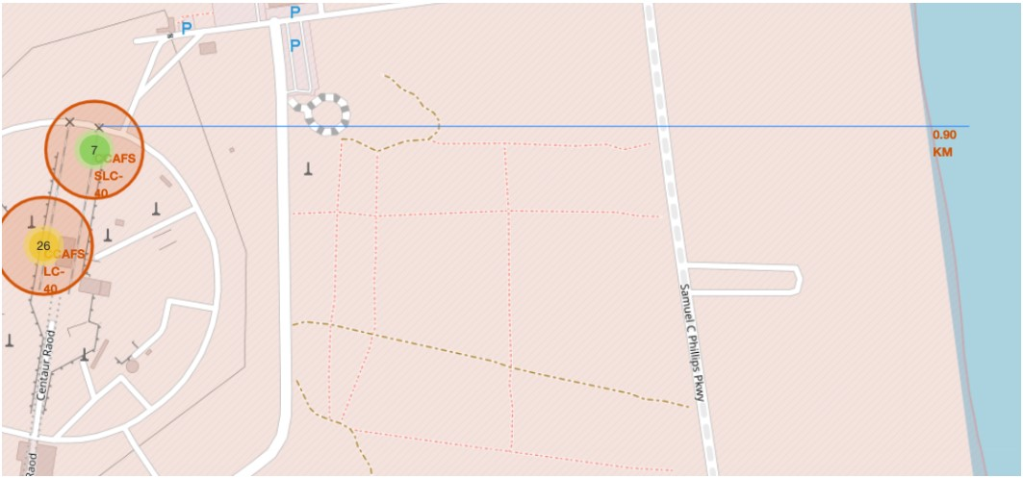
Proximate Distances
This map shows the locations of features nearby to launch sites and allows for the calculation of distances

Slide 38

Section 4

Slide 39
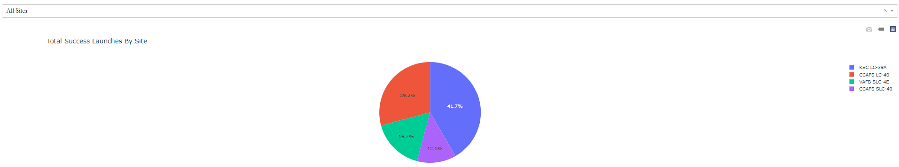
Overall Success Rates
This pie chart shows the number of total successful launches broken down by launch site, as well as the drop down menu to choose a launch site for further analysis

Slide 40
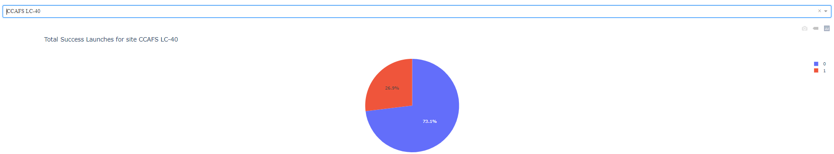
Individual Site Success Rate
This pie chart shows the success rate of landings for an individual launch site, chosen from the drop down menu of all different sites

Slide 41
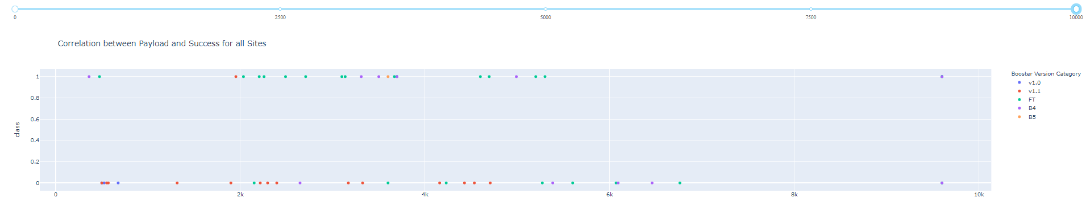
Impact of Payload on Success Rates
This scatter plot shows the success rate of landings plotted against the payload mass of each launch

Slide 42

Section 5

Slide 43
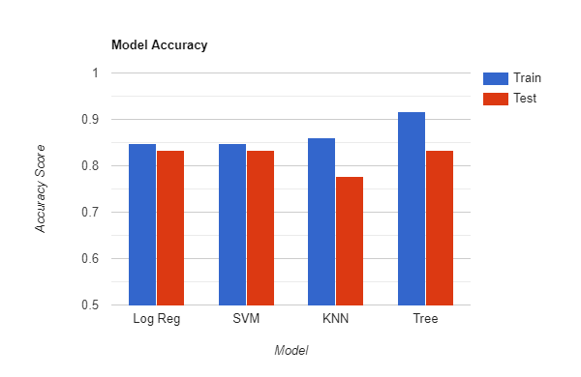
Classification Accuracy
3 out of 4 models had the same testing accuracy of 83.33%
K nearest neighbors had the lowest test accuracy of 77.77%
Classification tree had the highest overall accuracy between both training and testing sets

Slide 44
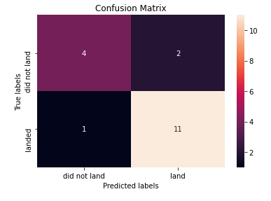
Confusion Matrix
The decision tree classifier confusion matrix show a high rate of accuracy with only a very small amount of both false positives and false negatives

Slide 45
Conclusions
It is possible to predict whether or not a Falcon 9 rocket will be landed successfully with greater than 83% accuracy
This information allows for better estimation of the true costs of each rocket launch based on if the first stage will be able to be reused
Launch variables can be used by competing companies to provide evidence of higher than estimated costs if it is predicted that there will not be a successful landing, which is how SpaceX keeps its costs lower

Slide 46


